Slide 1
Experience and evaluation after the transition from Paper-Based to on-computer programming exams
Teo Eterović, MoEE :: v.prof.dr. Dženana Đonko

Slide 2
Intro
First computer based programming exam @ETF – 2007 Operational research course
Practicum in Software Solutions the first programming course that switched to computer based exams (2010)

Slide 3
Software Quality Assurence
3rd Year (II)
Web technologies
Software Engineering
- Decomposition, Many-to-Many-Agregation/ Transaction classes,Visitor pattern, Open Close Principe, Dependency Inversion Principle, Fascade DP)
- Programmatic UI - „by hand” GUI programming, Declarative UI, GUI designer (Observer DP)
- Common UI controls and UI Design Patterns
- UI Design Patterns – platform based
- Advanced Exception handling,Validation/ Crossvalidation, ErrorProviders, Logging
- Serialization, XML (Single responsibility principle)
- Shared libraries, Components/Reusable controls
- Graphics programming
- Threads, Tasks, Thread pools (Object/Thread pool pattern)
2nd Year (II)
Fundamentals in database systems
Object oriented analysis and design
System programming
2nd Year (I)
Algorithms and data structures
Practicum Software Solutions(OOP2 ?)
Programming techniques(C++/OOP)
1st Year
Fundamentals of Computing(C)

Slide 4
Intro - PSS
Practical course – very early ( III semester)
We give the students the requirements
They have to develop the solution trough their homework and add specific components, consulted by the teaching staff
One student – one project (>100 projects !)
Exam:
Multiple-choice/open questions(20%)
Programming assignments (80%)

Slide 5
To do the exam on the Computer enabled me to better demonstrate my knowledge
81% agree
8% disagree
Highest score
4,5 Agree
1,2 disagree
80 students participated in the survey
Scale: 1 Highly Disagree - 5 Highly agree
Ignored

Slide 6
To do the exam on the Computer is easier than to do it on the paper
54% agree
27% disagree

Slide 7
To be able to use autocomplete/intellisense on the exam made the exam much easier
90% agree
4% disagree

Slide 8
I need more time to prepare for the computer based exam than to a paper based one (programming)
28% agree
48% disagree

Slide 9
Autocomplete tools should be banned on the exam in order to memorize the syntax! - real-life
10% agree
74% disagree

Slide 10
The programming language documentation should be allowed on the exams – mixed opinions
45% agree
37% disagree

Slide 11
To do an exam on the Computer takes more time than to do it on the paper(same task) - BUGS!
47% agree
31% disagree

Slide 12
I think it is important that the program compiles, in order to successfully pass the exam
50% agree
20% disagree

Slide 13
The computer based exams should be used in the following years
89% agree
6% disagree

Slide 14
It’s easier to cheat on a computer based programming exam
9% agree (~7 students)
65% disagree

Slide 15
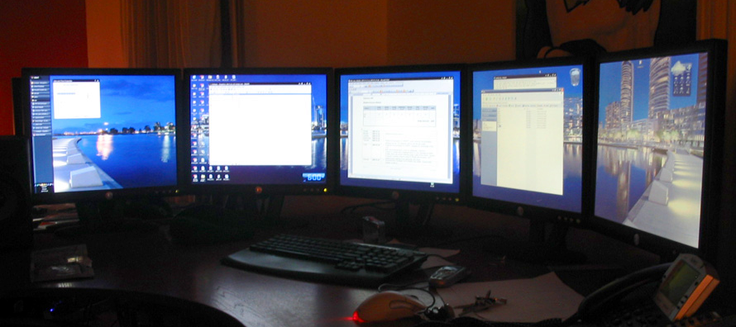
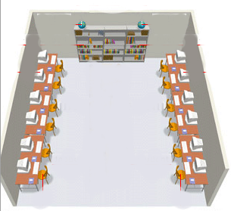
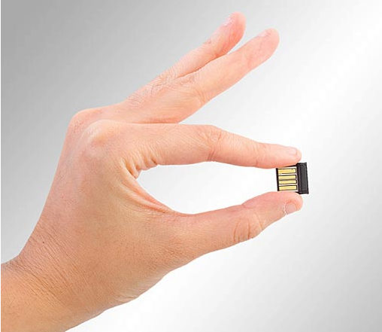

Slide 16
Load/Stress on a computer based exam is higher that on a paper based one? (not enought excercise > bugs > no time > fail)
53% agree
28% disagree
8 slides till the break

Slide 17
The computer based exam should be introduced on other programming courses, especially fundamental programming courses
66% agree
14% disagree
7 slides till the break

Slide 18
To prepare for a computer based exam contributed to better understand the course material
69% agree
7% disagree
6 slides

Slide 19
Objective stats
2009 (paper based exam)
I midterm: students: 78 sucessfull:56 72%
II midterm: students: 78 sucessfull:53 69%
2010 (first time – computer based exam)
I midterm: students: 66 sucessfull:41 62%
II midterm: students: 66 sucessfull:40 60%
2011
I midterm: students: 82 sucessfull:48 58%
II midterm: students: 82 sucessfull:50 61%
10% DROP
:P

Slide 20
Pros/Cons
The students like it – it’s closer to real-life
They love the "tools" (code generation, autocomplete, refactoring, ...)
The students agree that it is important that the program compiles
It's harder to cheat(but they tried)
It helped them to better understand the course material
Easier for the teachers to evaluate the exams (don't have to do it in the head for bad solutions, no ugly handwriting)

Slide 21
Pros/Cons
The programming tasks have to be shorter (it takes longer to do them – Trade-off (compiling - quality(?) vs. quantity)
More stress for the students(bugs)
The teaching assistant has to be skilled in IT to react to possible problems(software/hardware problems)
It’s hard to find a classroom with 100+ computers and check them all before the exam

Slide 22
What we think
The exam reviewer is not anymore a compiler (still a code analyser and tester –but it’s much easier now)
It was usual that student come to have an insight in their exams and say „I would not make this typo in real-life - if i had an compiler”
The students memorized parts of code sometimes without to understand it, now it has to work as a whole
When reviewing the paper based exam we were much more subjective:
This is a typo (funny thing there are syntax typos when they code on the computer !)
Variable declaration missing (he didn’t see it – still happens on computer based exams!)

Slide 23
Conclusion
Students happy ☺ - a 10% drop ?:) ...
We give them something (real-life programming, autocomplete), we take them something(it must compile, no typos)
Harder for the teaching staff and the students but we realize that it’s better so

